Slide 1
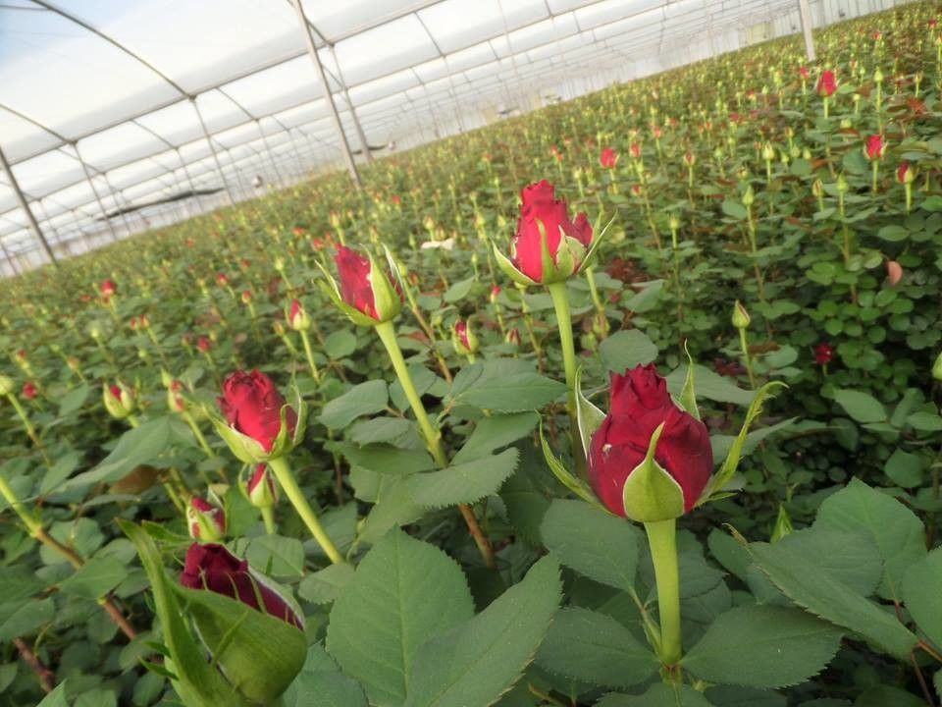
Harvesting is done with sharp secateure at the tight bud stage when the colour is fully developed and the petals have not yet started unfolding. There should be 1-2 mature leaves (those with five leaflets) left on the plant after the flower has been cut.

Slide 2
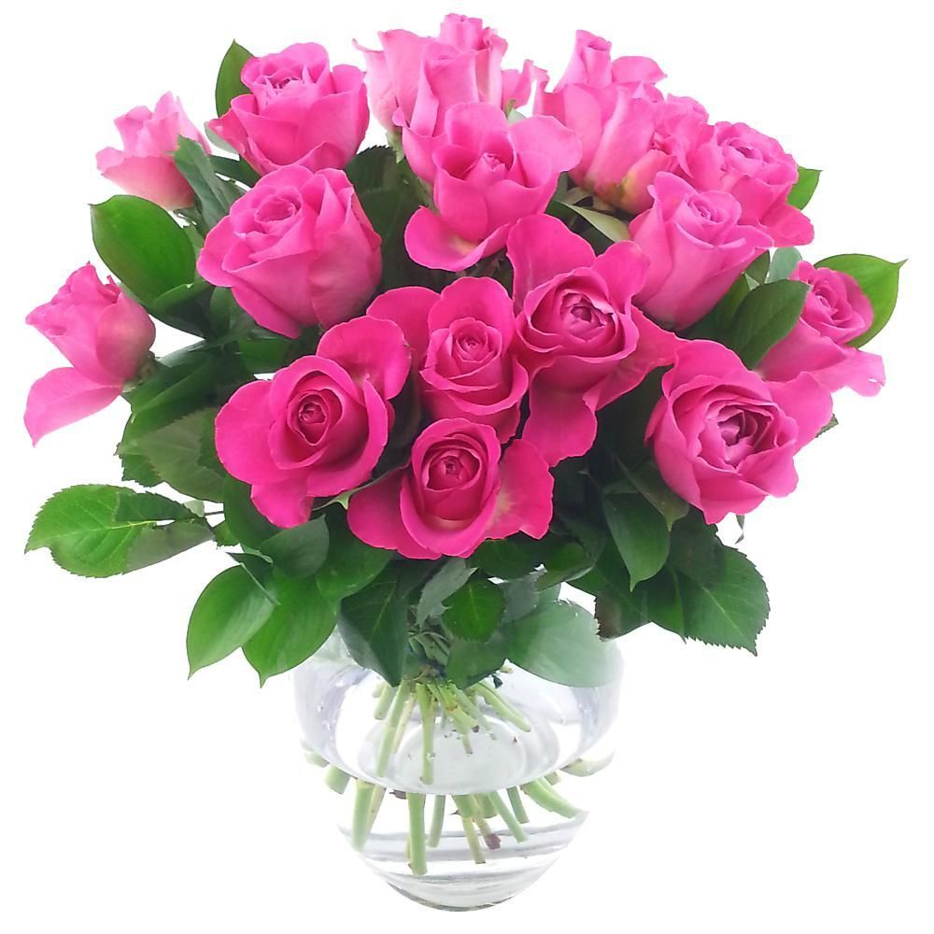

Slide 3
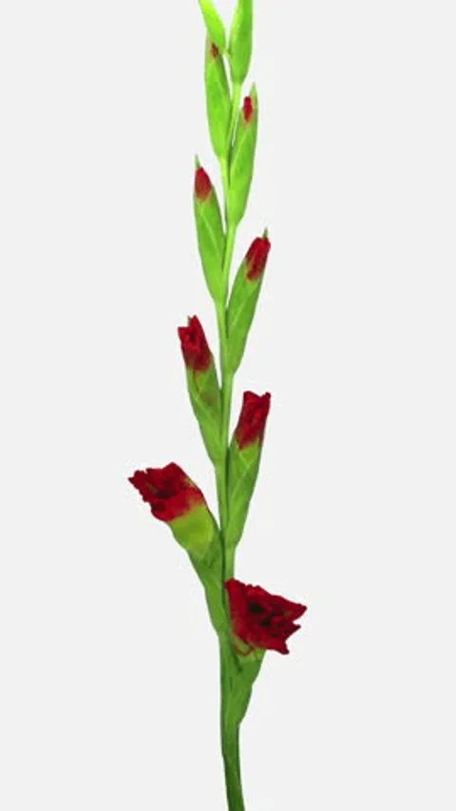
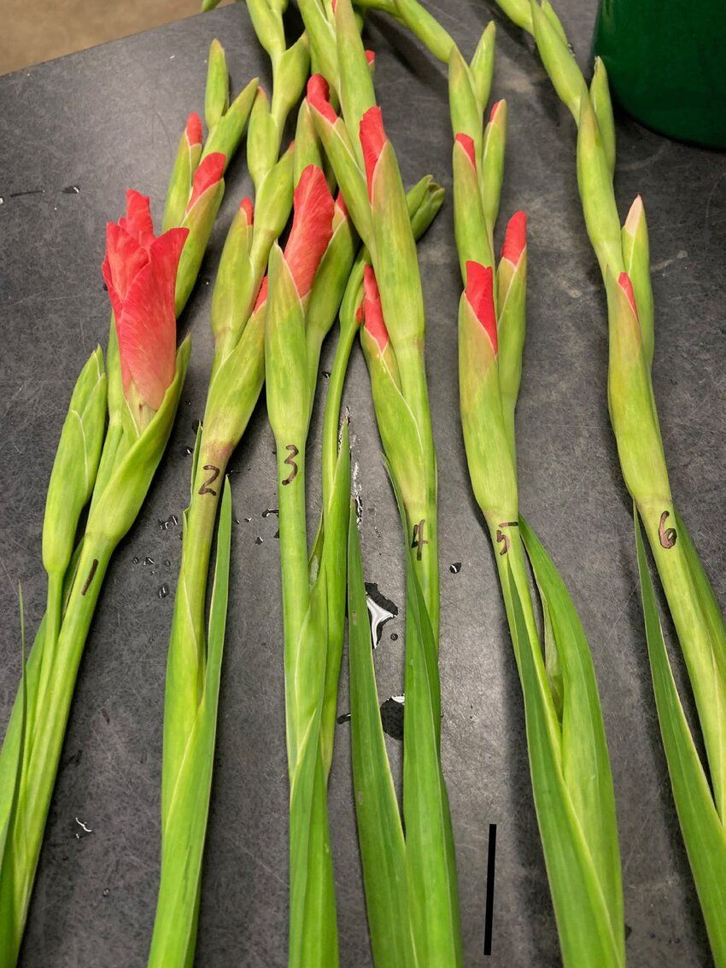
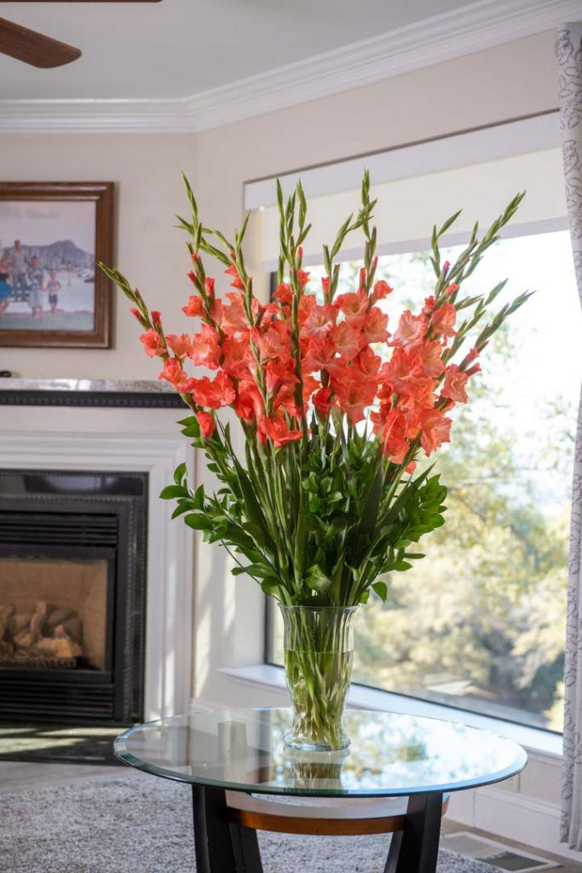
The spikes should be harvested at tight bud stage, with one to five florets showing colour and at least four leaves on the plant for development of corms and cormels.

Slide 4
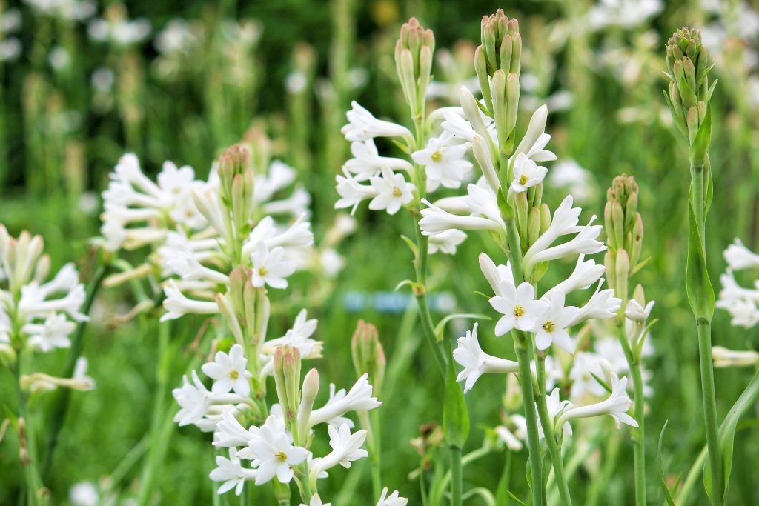
Spikes are harvested at bud- burst stage(most of the floret in the spikes are open) preferably in the morning before sunrise or late in the evening by clipping with a sharp knife or secateurs

Slide 5
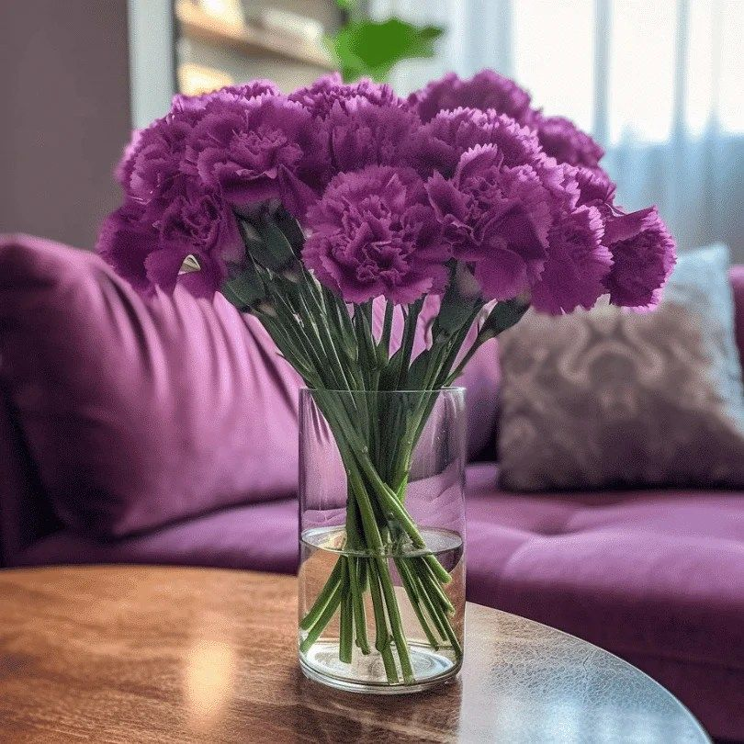
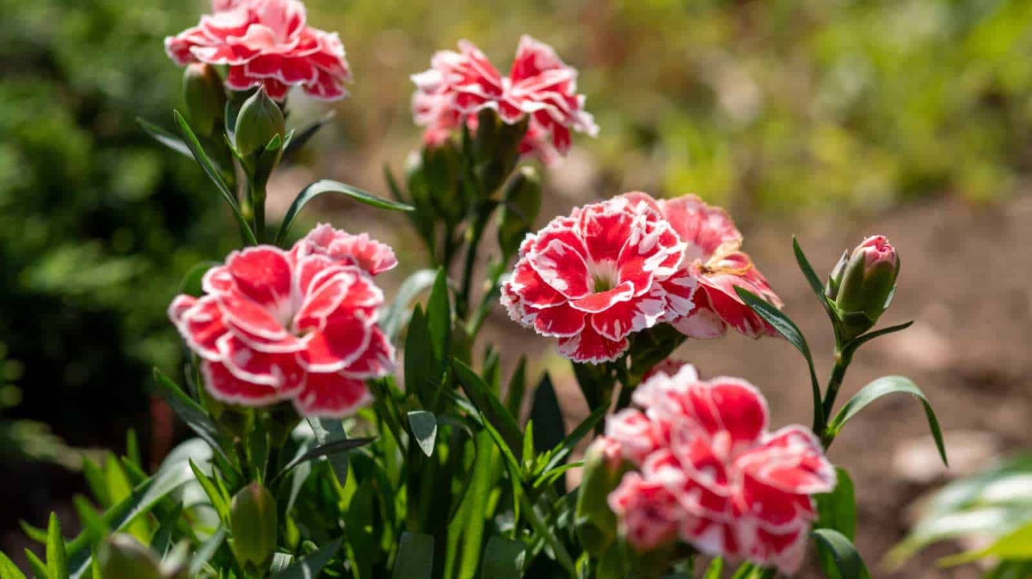
When the petals are fully colored and the flower is starting to open

Slide 6
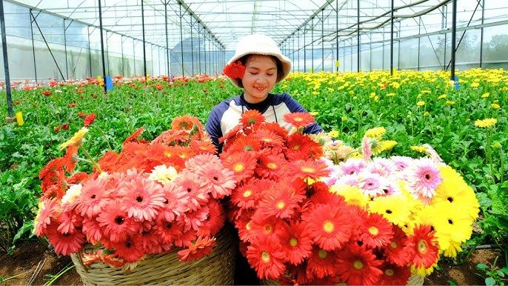
. Gerbera: When the flower head is fully open and the petals are firm.
https://www.youtube.com/watch?v=cHTzlE6LClg

Slide 7
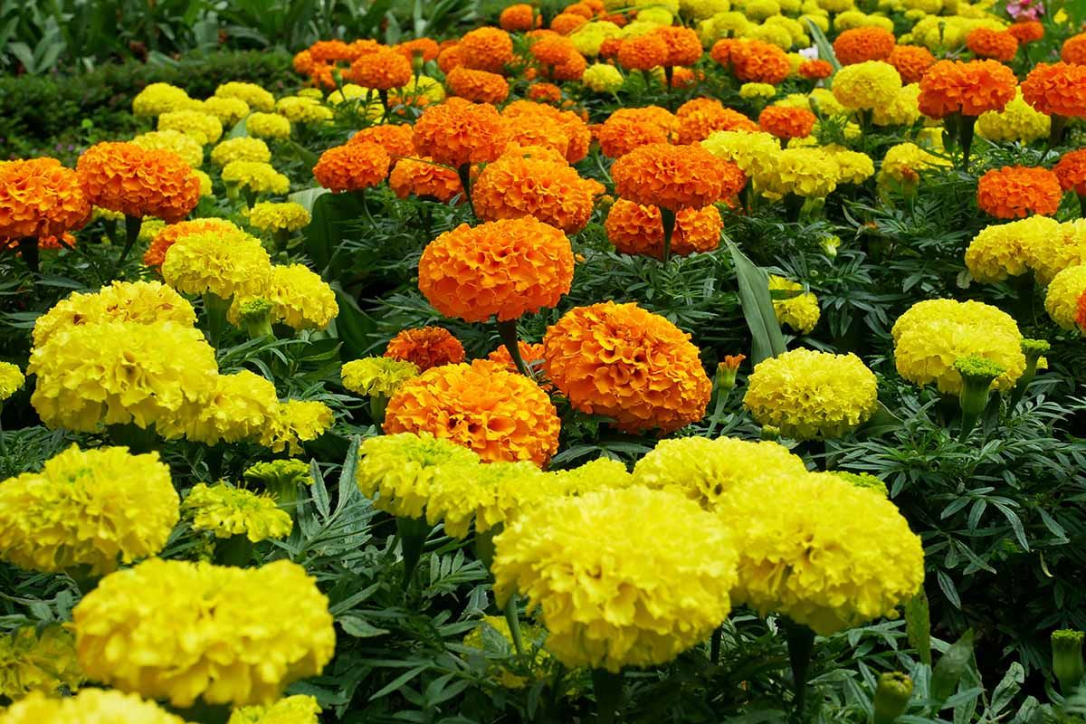
Marigold: When the flower heads are fully open and the petals are firm.

Slide 8
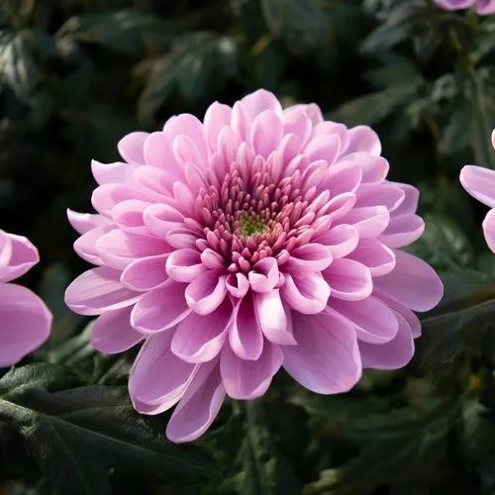
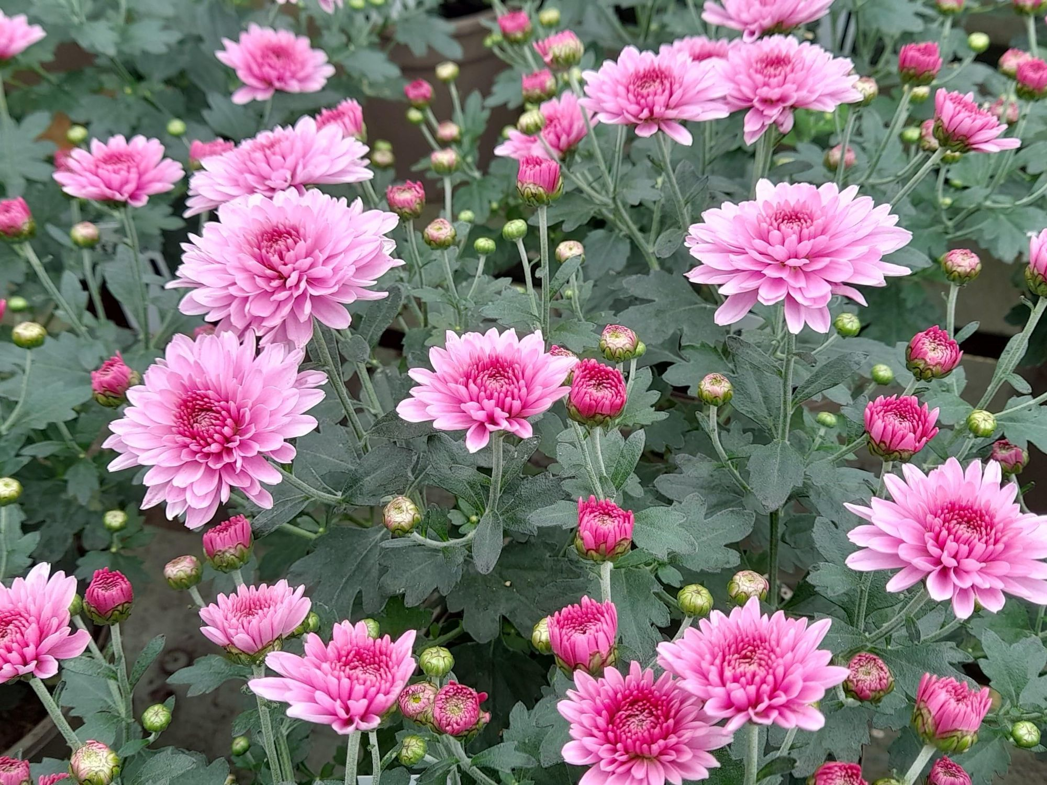
Chrysanthemum: When the ray florets are fully open and the petals are firm.

Slide 9
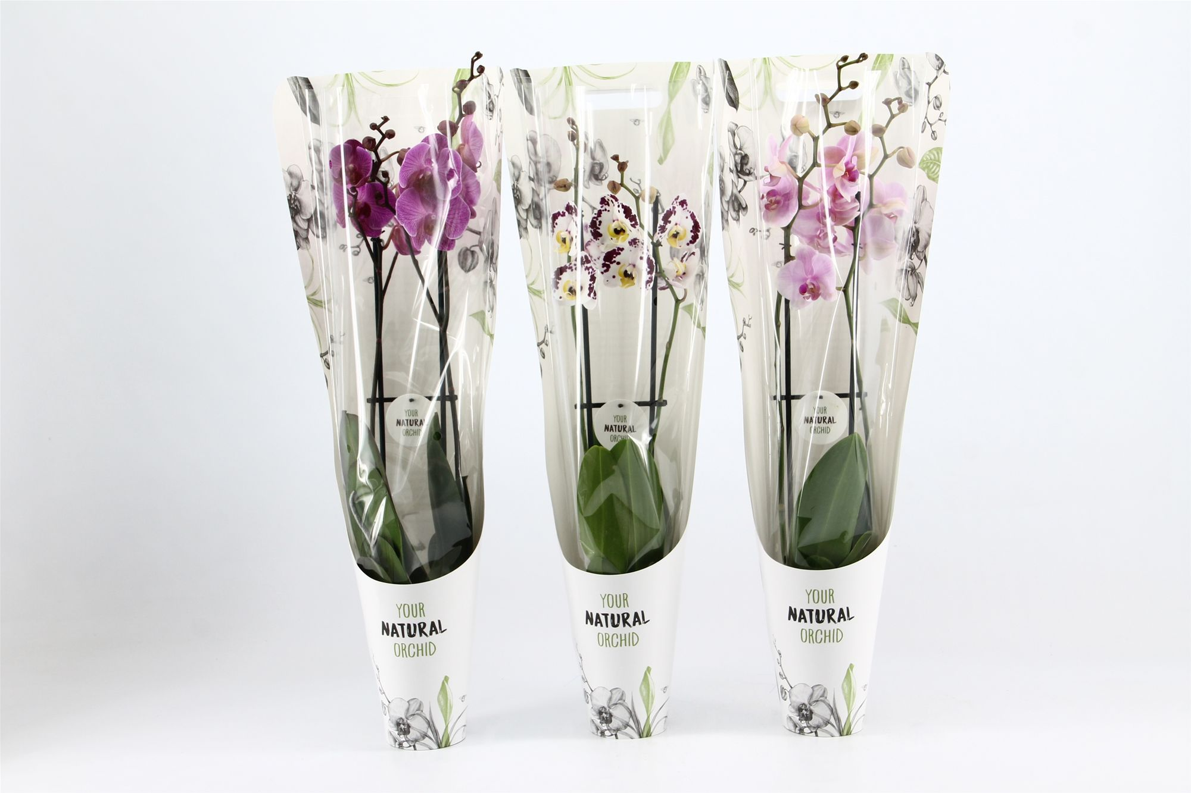
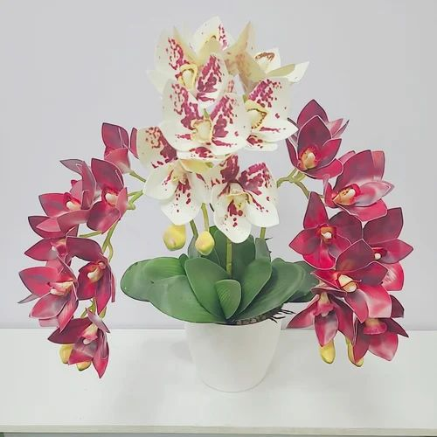
When the flower is fully open and the lip is fully expanded.

Slide 10
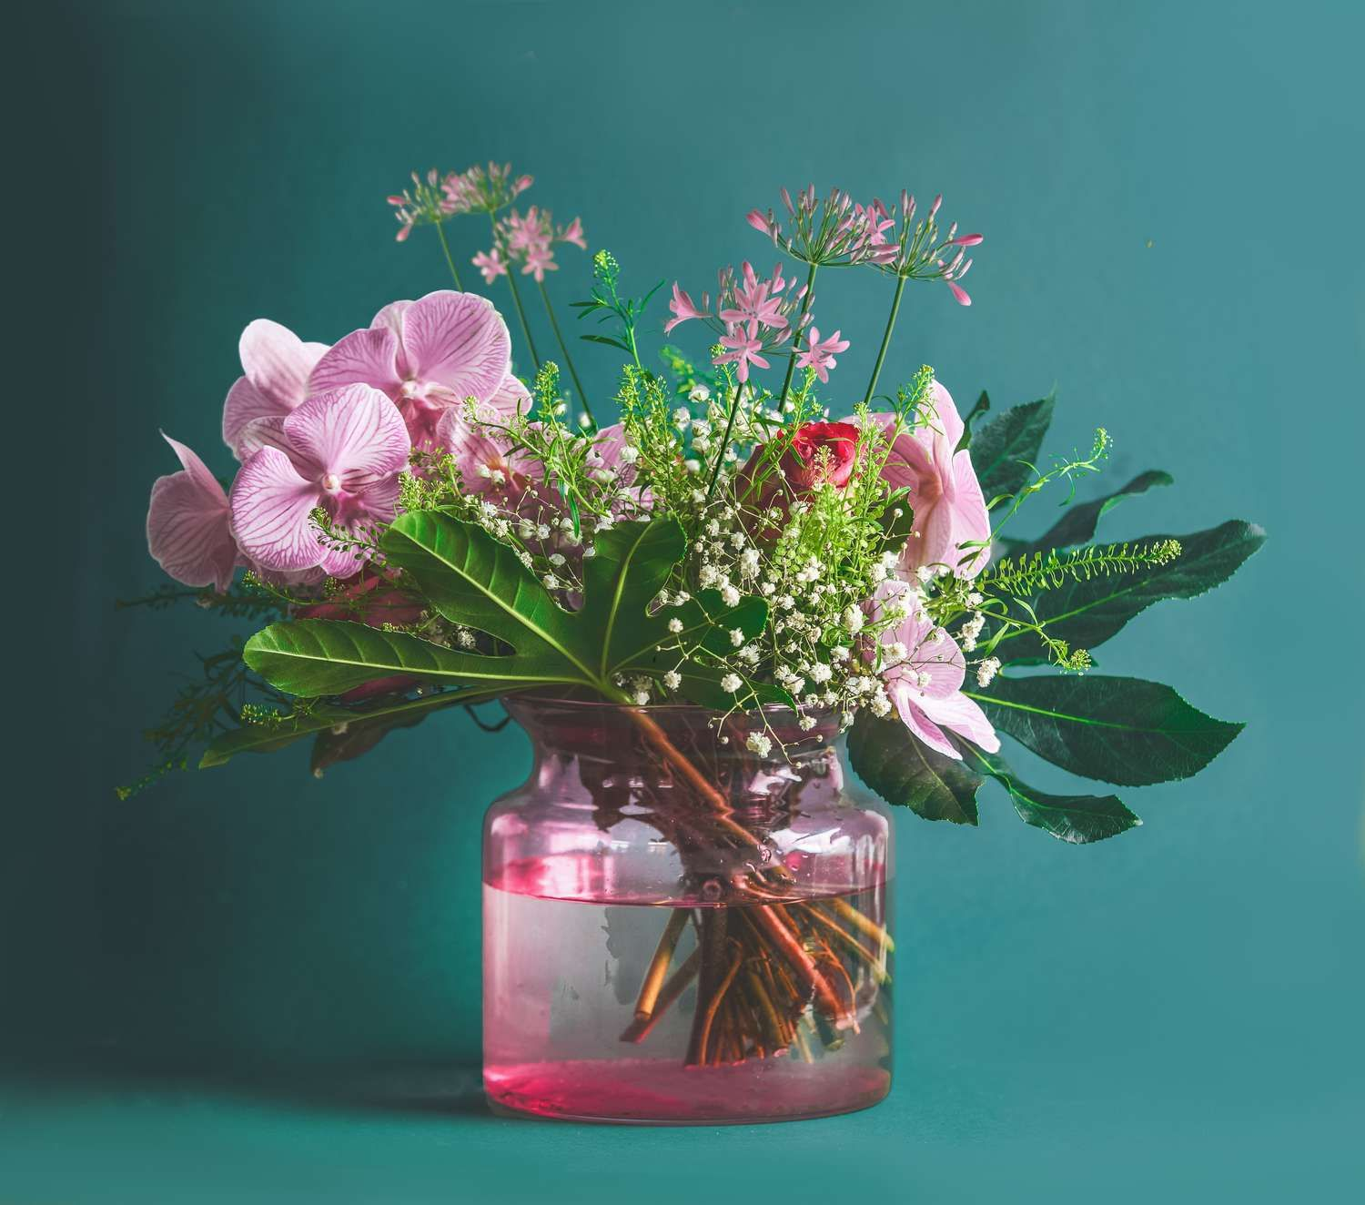
What is a Vase?
A vase is a container, typically decorative, used to hold and display cut flowers or other ornamental plants. They come in various shapes, sizes, and materials, adding aesthetic appeal to any space
a vase solution to extend flower life is a mixture of sugar (like sucrose) as a carbohydrate source, a small amount of citric acid to acidify the water, and a bactericide like 8-hydroxyquinoline (8-HQS); this combination provides nourishment to the flower while inhibiting bacterial growth, leading to a longer vase life

